Slide 1

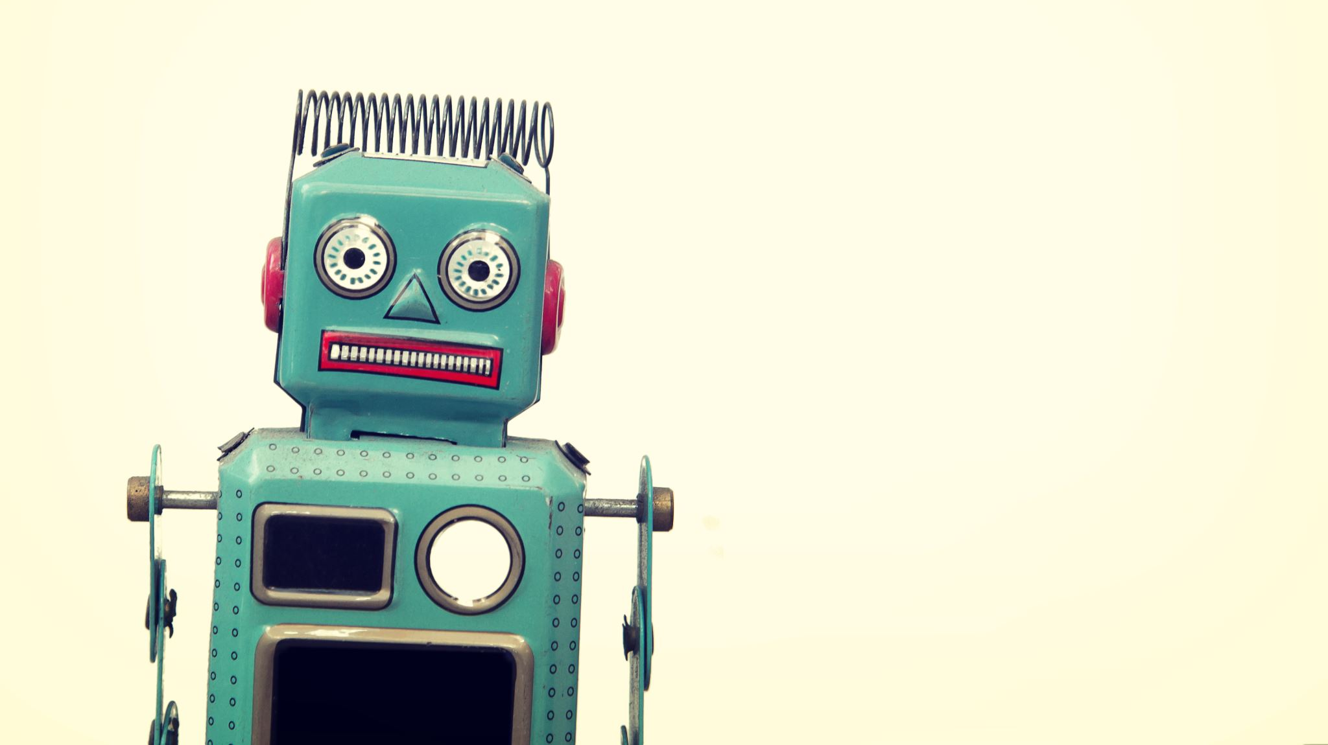
Mobile robot

Slide 2
Mobile robot
simple simulation with pytest framework

Slide 3
Design assumptions

Slide 4
Design assumptions
The simulated mobile robot is an object that is defined as a point in a 2D environment.
y
x

Slide 5
Design assumptions
The simulated mobile robot is an object that is defined as a point in a 2D environment.
The state of the robot is uniquely defined by the x and y coordinates in this 2D coordinate system.
y
y_{i}
x_{i}
x

Slide 6
Design assumptions
The simulated mobile robot is an object that is defined as a point in a 2D environment.
The state of the robot is uniquely defined by the x and y coordinates in this 2D coordinate system.
The robot can move freely along x and y axis with a single movement distance limited to 10 units.
y
(v_{x} , v_{y})
y_{i}
x_{i}
x

Slide 7
Design assumptions
The simulated mobile robot is an object that is defined as a point in a 2D environment.
The state of the robot is uniquely defined by the x and y coordinates in this 2D coordinate system.
The robot can move freely along x and y axis with a single movement distance limited to 10 units.
y
The robot is able to read its position using a position sensor which has a certain accuracy.
(v_{x} , v_{y})
y_{i}
x_{i}
x

Slide 8
System requirements
The robot system shall have software safeguard preventing any attempt to move more than the allowed distance.
The robot system shall have a software safeguard preventing it to move outside given borders in the 2D environment.
The robot shall be able to move by a given vector in the simulated environment.
The robot system shall be able to calculate the cumulative position change from a stored record of all movements.
The robot system shall be able to read position sensor and return the measurement result.
The robot system shall save a record of all movements.

Slide 9
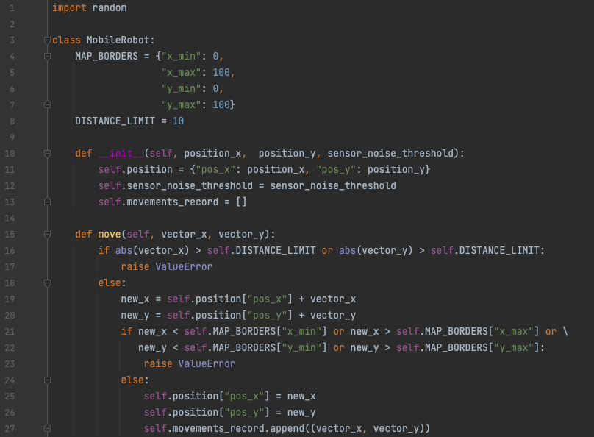
Mobile robot implementation

Slide 10
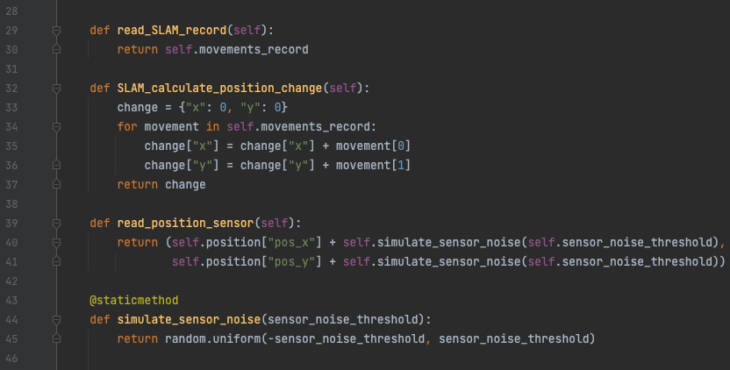
Mobile robot implementation

Slide 11
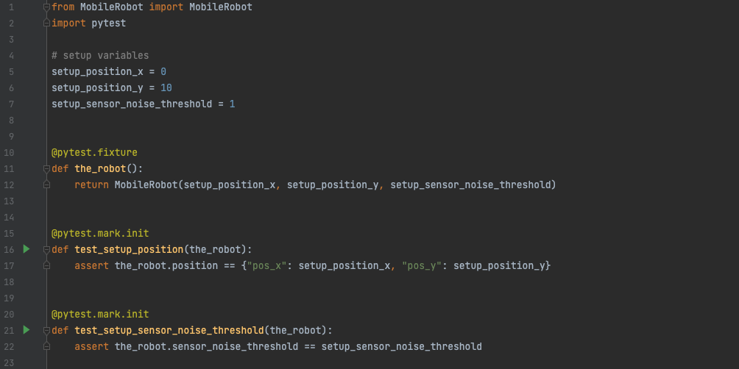
PYTEST SETUP and initialization testing

Slide 12
TESTING
The robot system shall have software safeguard preventing any attempt to move more than the allowed distance.
The robot system shall have a software safeguard preventing it to move outside given borders in the 2D environment.
The robot shall be able to move by a given vector in the simulated environment.
The robot system shall be able to calculate the cumulative position change from a stored record of all movements.
The robot system shall be able to read position sensor and return the measurement result.
The robot system shall save a record of all movements.

Slide 13
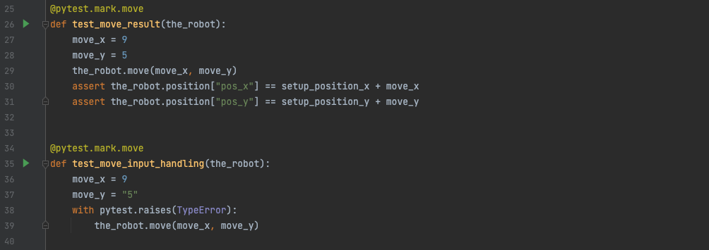
Testing
The robot shall be able to move by a given vector in the simulated environment.

Slide 14
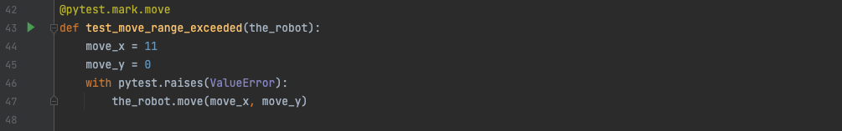
TESTING
The robot system shall have software safeguard preventing any attempt to move more than the allowed distance.

Slide 15
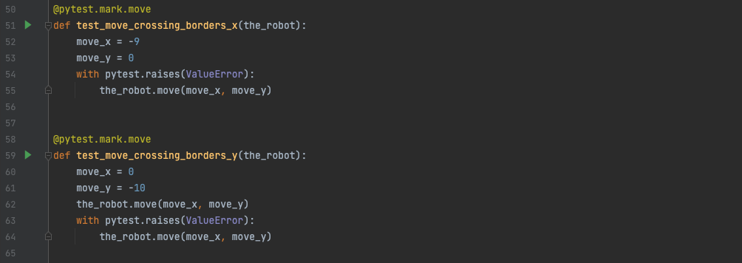
TESTING
The robot system shall have a software safeguard preventing it to move outside given borders in the 2D environment.

Slide 16
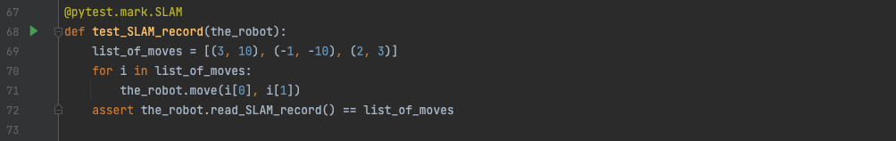
TESTING
The robot system shall save a record of all movements.

Slide 17
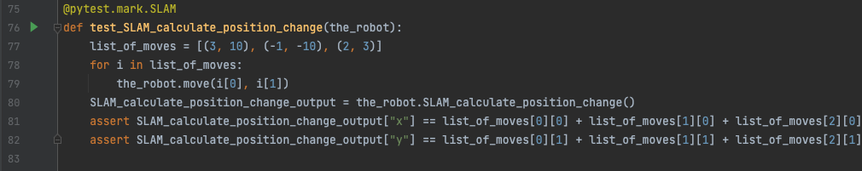
TESTING
The robot system shall be able to calculate the cumulative position change from a stored record of all movements.

Slide 18
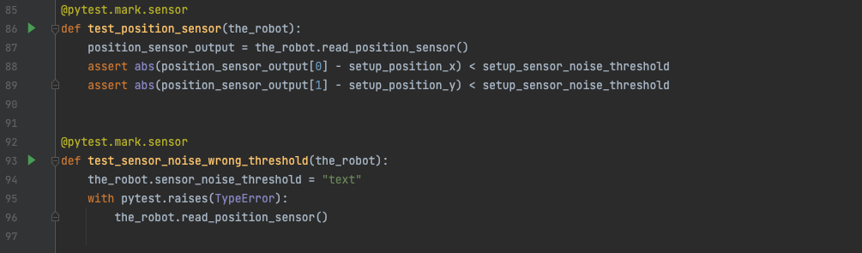
TESTING
The robot system shall be able to read position sensor and return the measurement result.

Slide 19
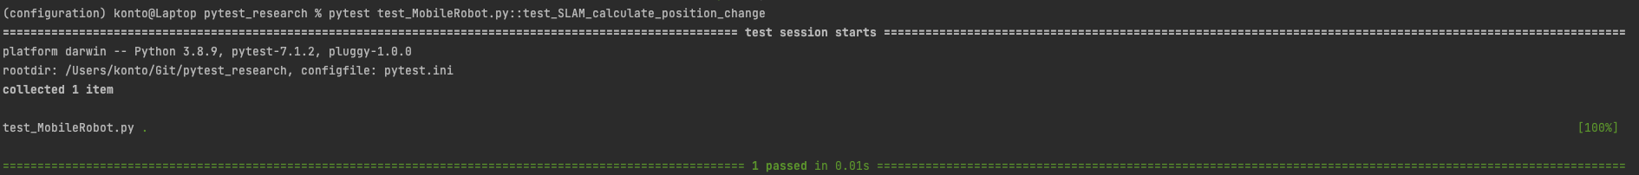
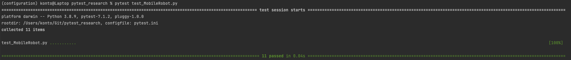
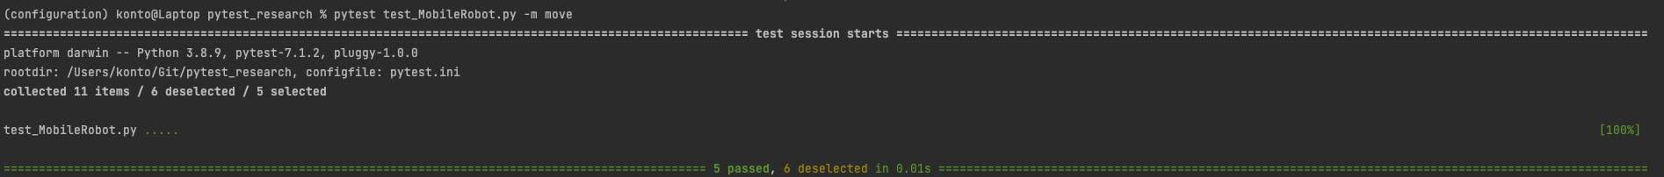
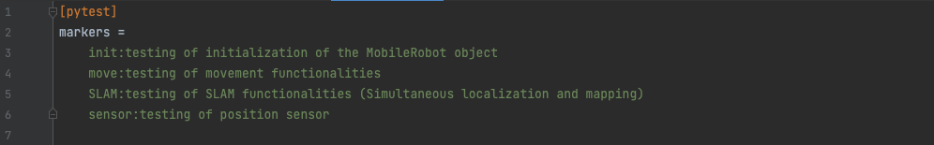
TESTING environment

Slide 20
Thank you for your attention

